Slide 1
Scale Up to Stepping Up!
© Stepping Up! LLC, 2021

Slide 2
Agents retire, and their clients typically go away!
And
But, not anymore!
Their
Income
Goes
With
Them!
© Stepping Up! LLC, 2021

Slide 3
We help retain clients and revenue …
For Retiring Agents and our Teams!
Scale Up and become part of our Stepping Up! Team
© Stepping Up! LLC, 2021

Slide 4
The Problem:
If Retiring Agents are not seen as active . . .
. . . Their clients will go elsewhere!
The Solution:
Retirement income for Agents
Total Marketing Support
Systems to make it happen
Infrastructure to handle increased volume
© Stepping Up! LLC, 2021

Slide 5
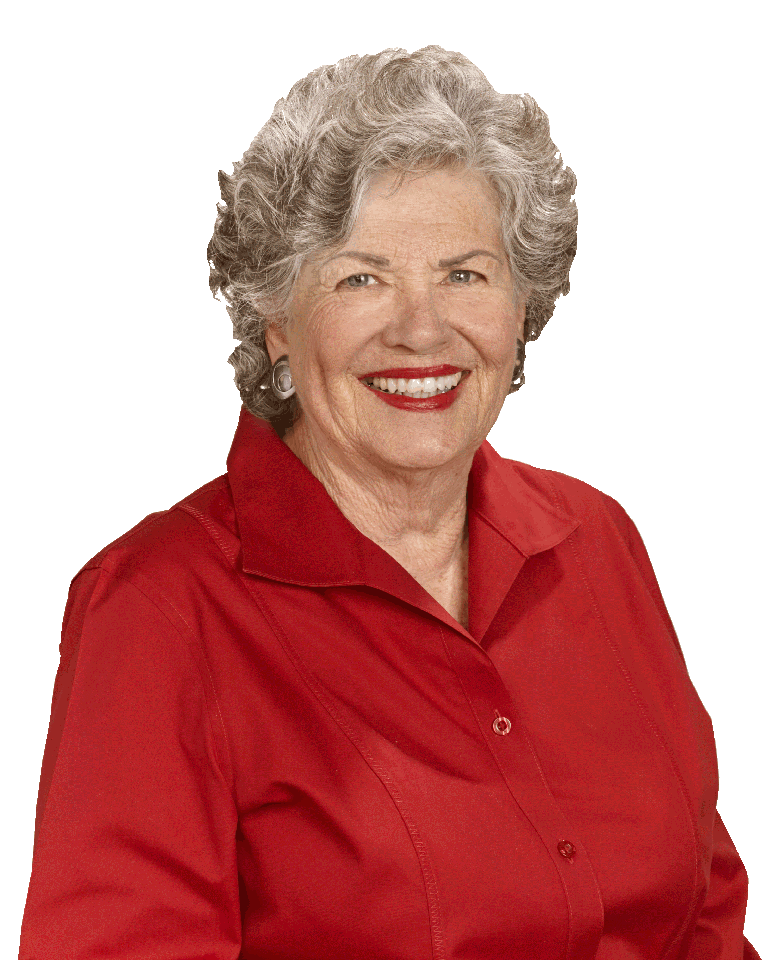
What our Teams say:
Heather Shallenberger, Long Realty (Stepping Up! Team Lead)
I loved the idea of being able to help agents retain income that they deserve after years of dedication to their clients. … there is no doubt that I will take full advantage of being a Stepping Up! referring agent myself one day.
Sherie Broekema, Long Realty (Retiring Agent, 8 years)
Clients respect and enjoy working with the Team. The best part - the whole Team treats Referral Agents as A+ Clients!
© Stepping Up! LLC, 2021

Slide 6
In Summary:
A Proven Strategy – marketing to reach Retiring Agents!
9+ years of success – 20+ Referral Agents served, $100M in revenue!
Scale Up to Stepping Up!
© Stepping Up! LLC, 2021

