Slide 1


Turn Your Dreams into Reality!
© Stepping Up! LLC, 2021

Slide 2

Retire, and your clients go away!
And
But, not anymore!
Your
Income
Goes
With
Them!
© Stepping Up! LLC, 2021

Slide 3

You’ve spent years building your business …
Don’t just walk away!
Step Up and become part of our Stepping Up! Team
© Stepping Up! LLC, 2021

Slide 4

The Problem:
If you are not seen as active . . .
. . . Your clients will go elsewhere!
The Solution:
Continue earning income
Total Marketing Support
We market in YOUR name at our expense
Tested infrastructure to handle Your volume
© Stepping Up! LLC, 2021

Slide 5

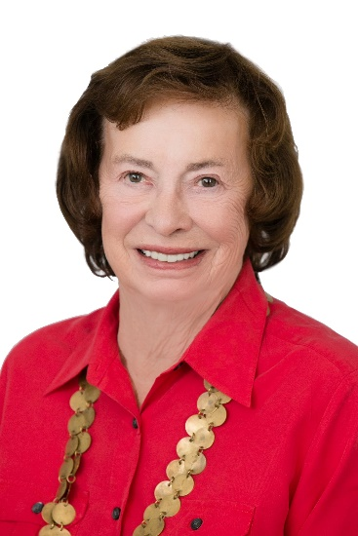
What our Team Members say:
Sherie Broekema, Long Realty
Clients respect and enjoy working with the Team. The best part - the whole Team treats Referral Agents as A+ Clients!
Barbara Murray, Long Realty
I’m delighted that our clients continue to be well-served. Plus, I can be involved as much or as little as I choose.
© Stepping Up! LLC, 2021

Slide 6

In Summary:
A Proven Strategy – marketing for YOU at OUR expense!
9 years of success – 25+ Referral Agents served, $100M in revenue!
Turn Your Dreams into Reality!
© Stepping Up! LLC, 2021

