Slide 1


The issue:
When agents retire, you lose clients!
© Stepping Up! LLC, 2021

Slide 2

But, not anymore!
And
Your
Income
Doesn’t
Disappear!
© Stepping Up! LLC, 2021

Slide 3

You’ve spent years building relationships …
Keep them!
Valued Agents who want to
“Step Out” of business can become part of our Stepping Up! Teams.
That means, the business is still there for You!
© Stepping Up! LLC, 2021

Slide 4

The Solution:
When you hear that one of your Valued Agents may be “stepping out”, encourage them to join “Stepping Up!” instead.
Our Commitment …
… We’ll help you keep your clients!
© Stepping Up! LLC, 2021

Slide 5
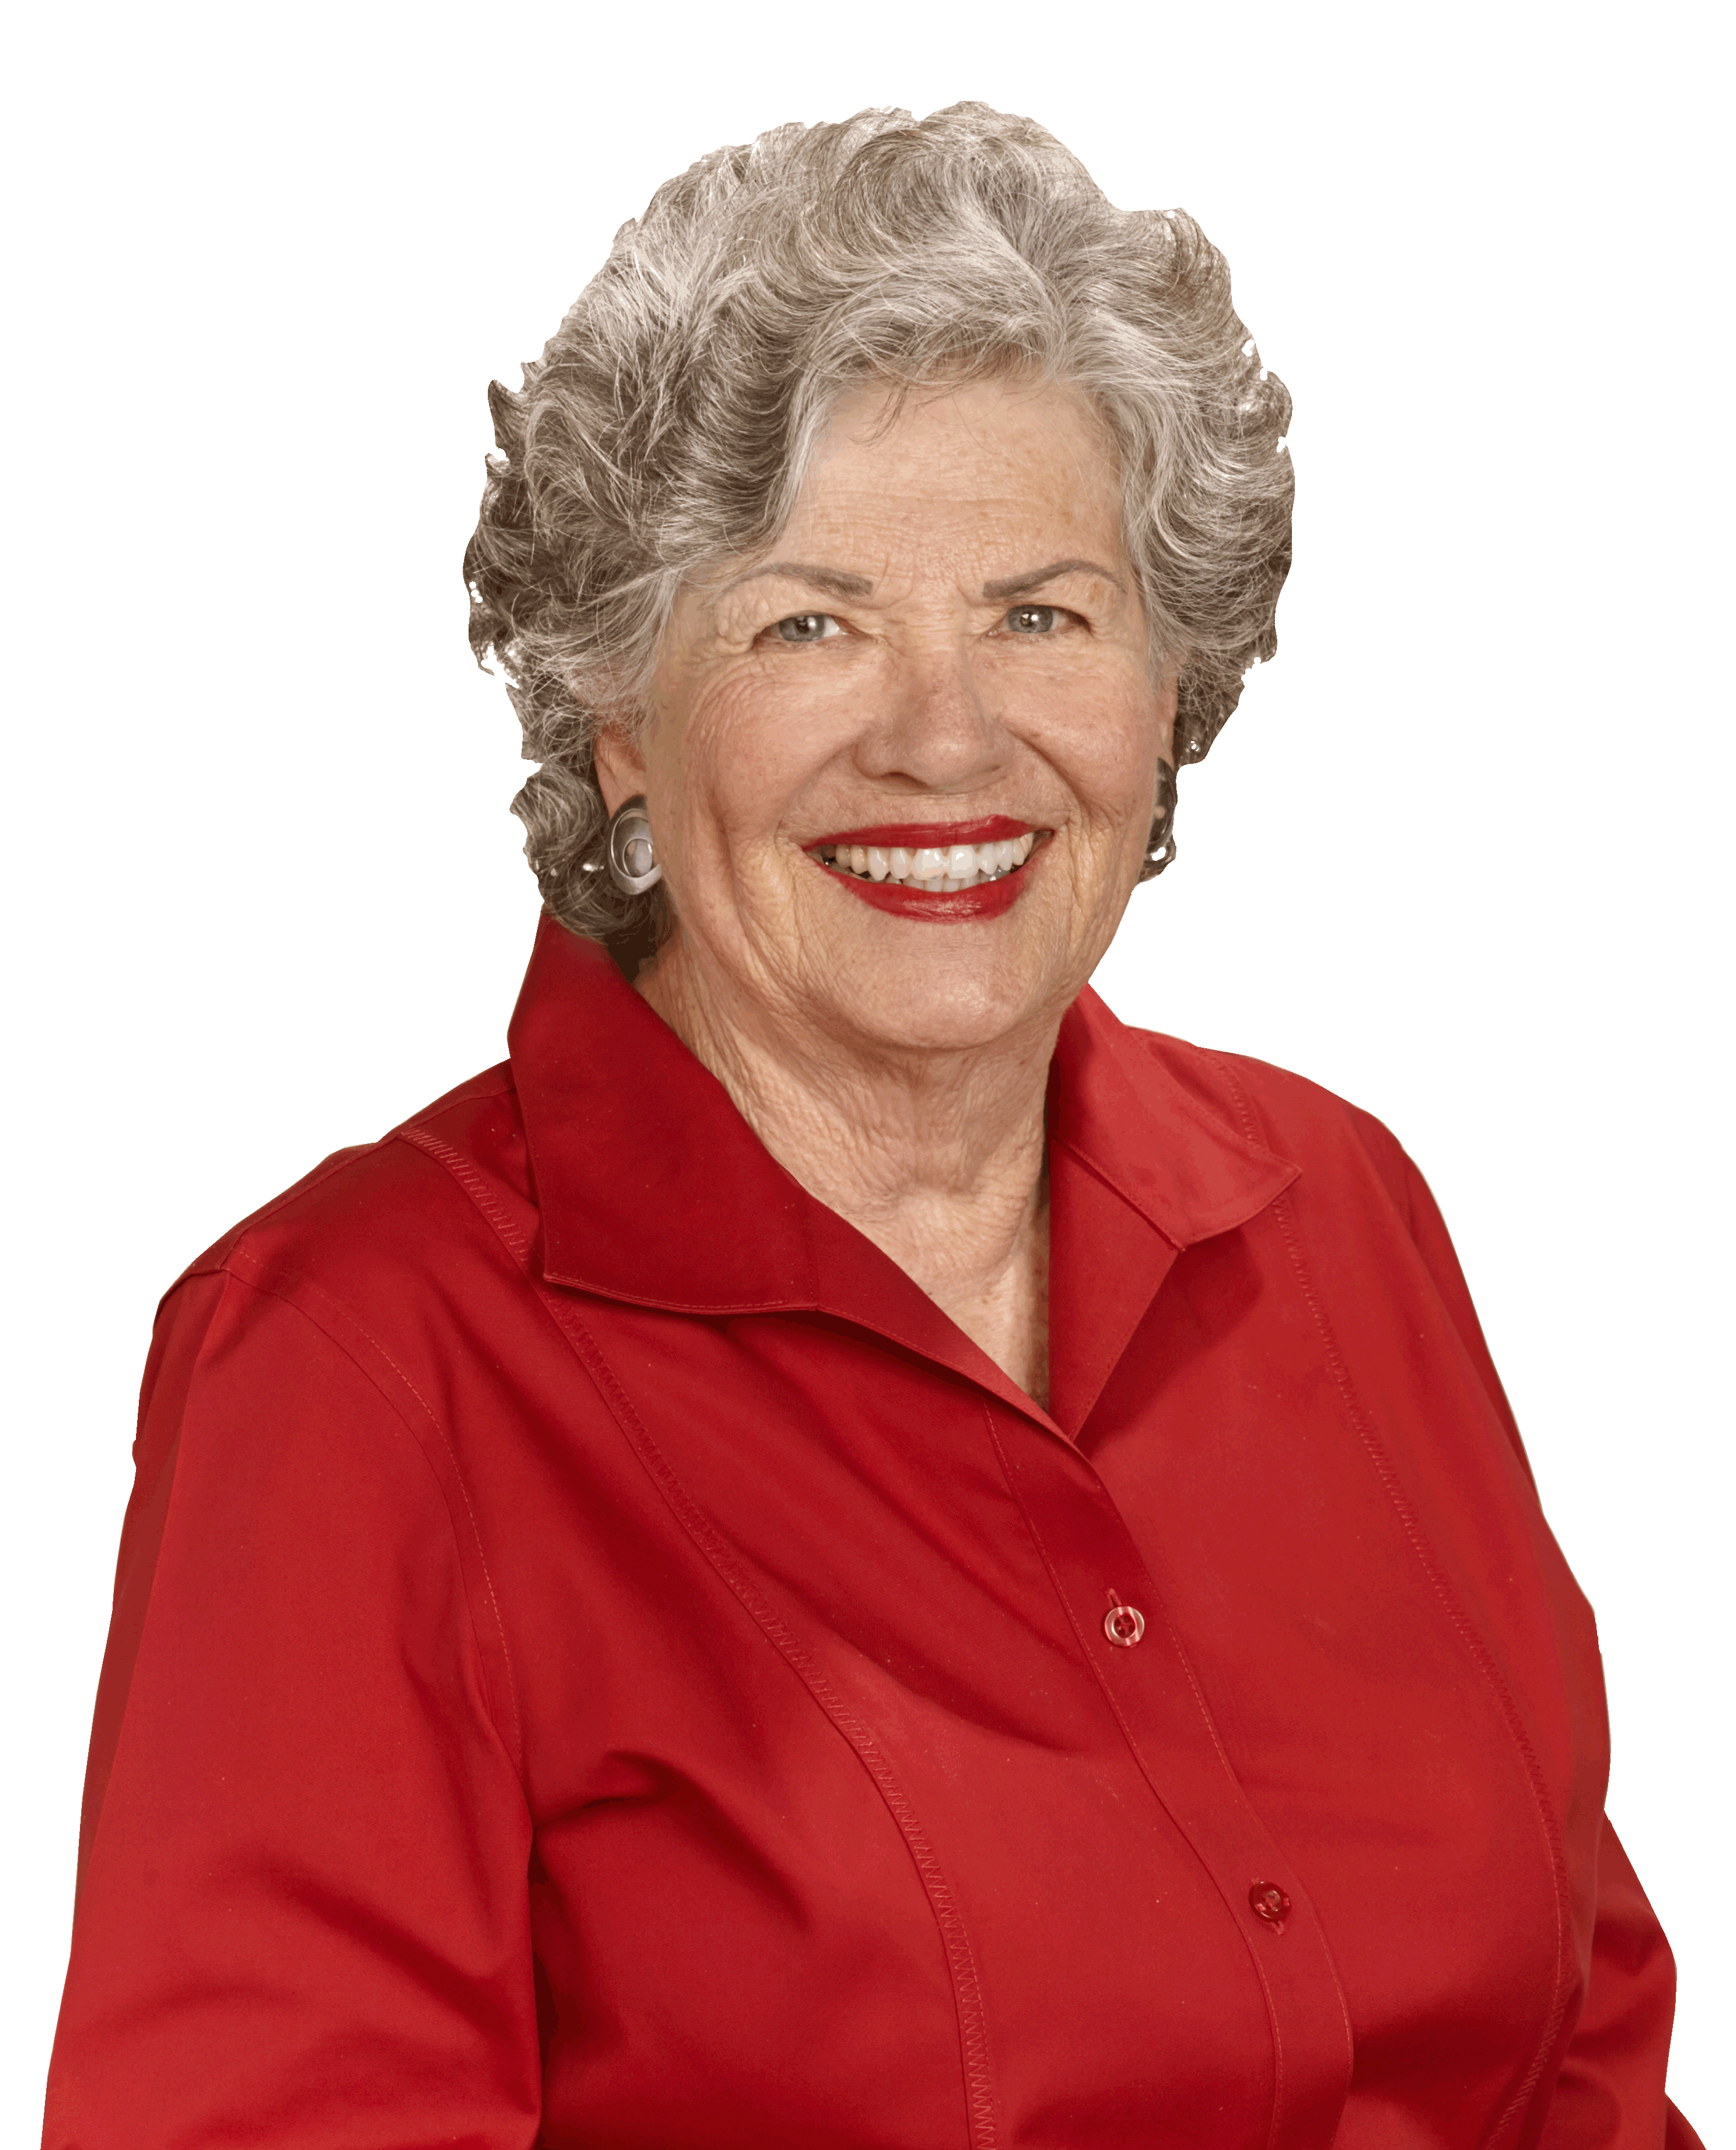
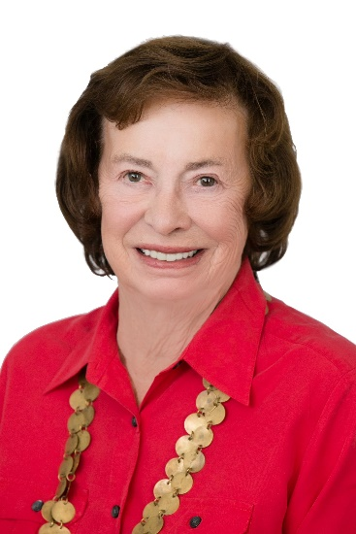
What our Team Members say:
Sherie Broekema, Long Realty
Clients respect and enjoy working with the Team. The best part - the whole Team treats Referral Agents as A+ Clients!
Barbara Murray, Long Realty
I’m delighted that our clients continue to be well-served. Plus, I can be involved as much or as little as I choose.
© Stepping Up! LLC, 2021

Slide 6

In Summary:
A Proven Strategy - 9+ years of success
We market the Agent at OUR expense!
We have the systems to make it work!
25+ Referral Agents served so far!
© Stepping Up! LLC, 2021

